Slide 1
Airbnb Project
Diana Melendez, Ericka Houle and Steven Green

Slide 2

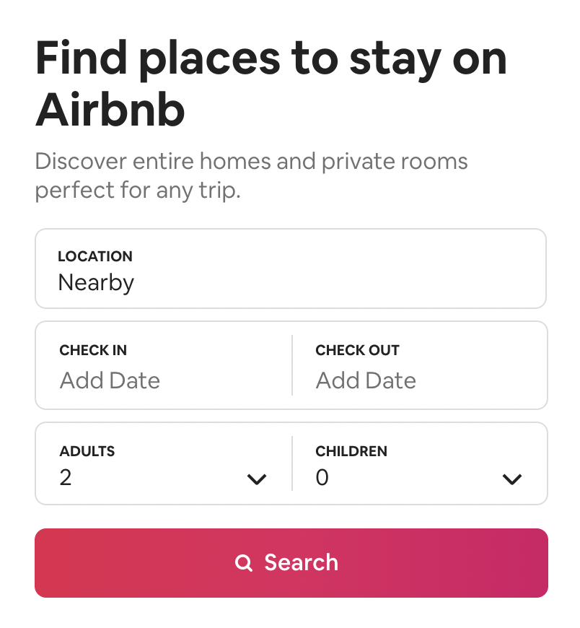
Agenda
Hypothesis
Data
Analysis
Projection
Limitations & Future Analysis
Q& A
Notes:
Present quick overview of project…….

Slide 3
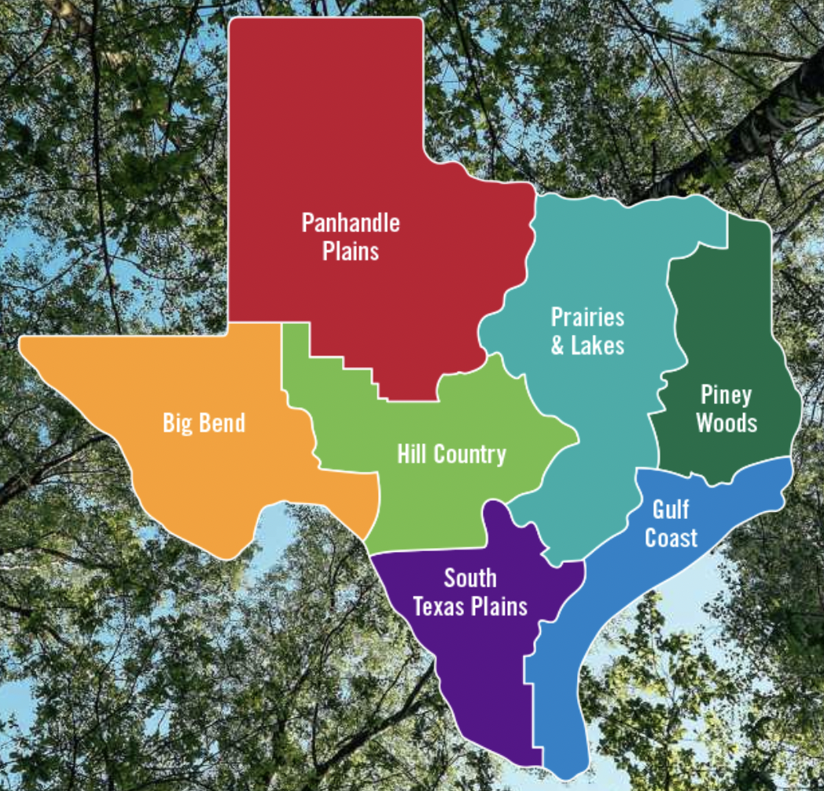
Hypotheses
There is less competition in rural areas due to higher rates.
There are more rentals in areas with tourism attractions.
Population and income affect Airbnb rates.
Deliverables
Vision
Team
Notes:
There is less competition in rural areas due to higher rates.
There are more rentals in areas with tourism attractions.
Population and income affect Airbnb rates.
We hypothesize that people want to get out of the city to relax, therefore there will be a higher number of rentals in rural areas.
There is a higher number of business travelers in urban areas, therefore there is a higher need for smaller rentals.

Slide 4
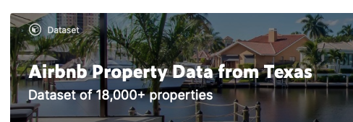

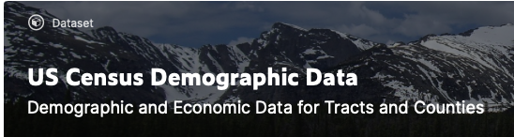
Datasets

Slide 5
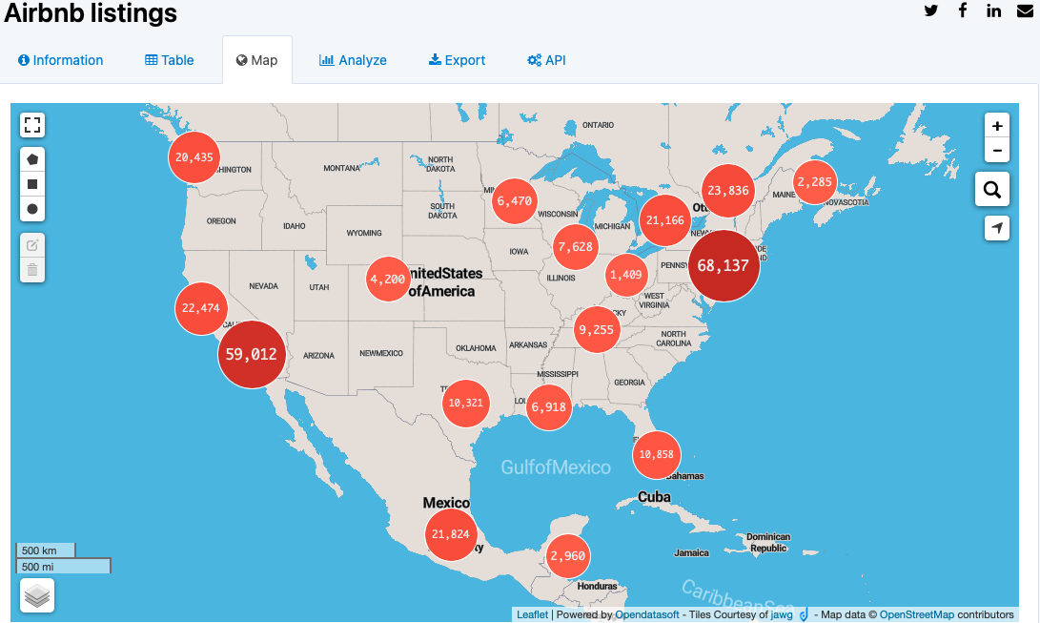


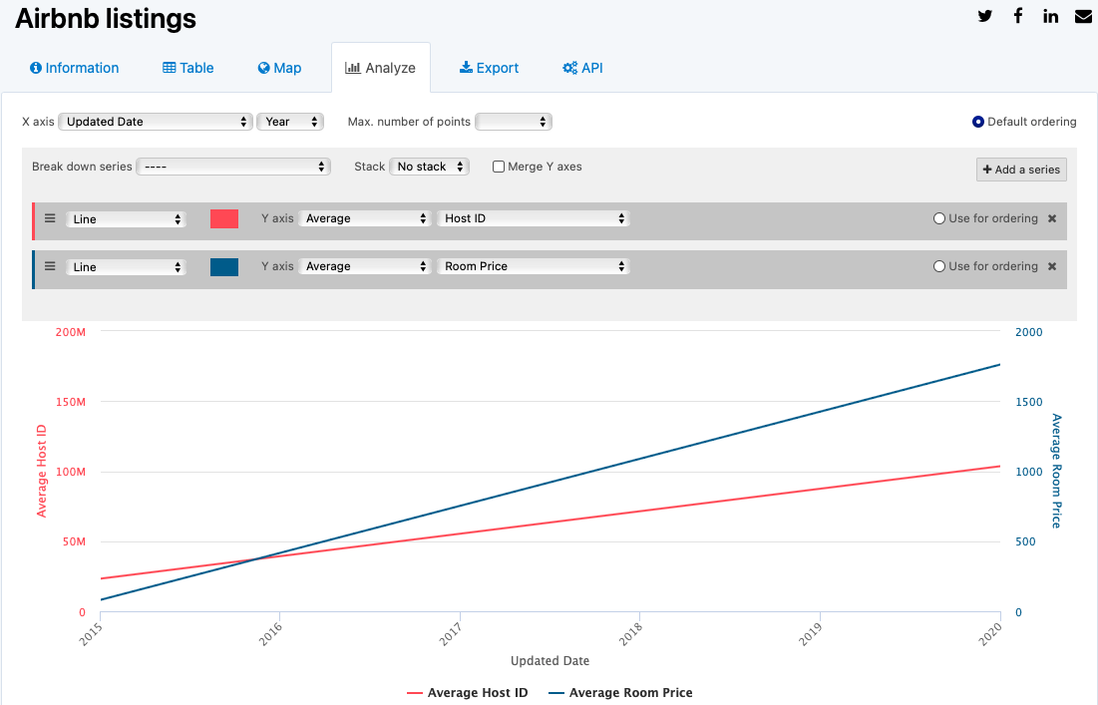
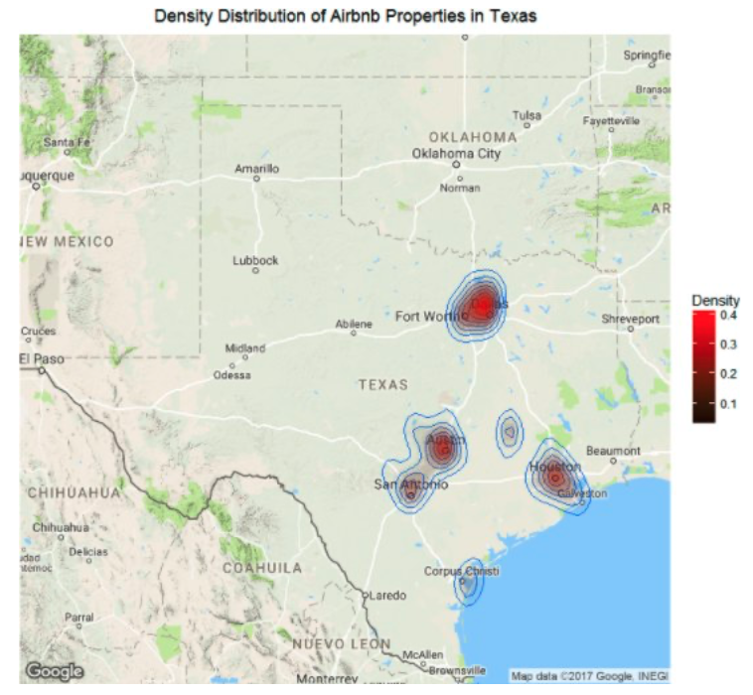
Inspiration

Slide 6
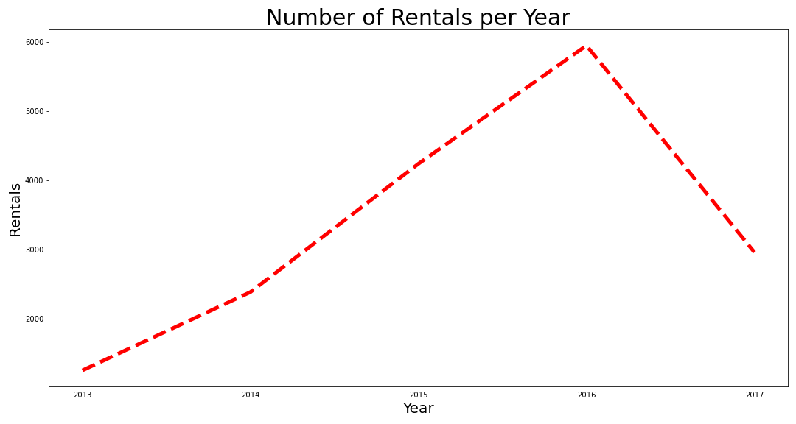
Deliverables
Vision
Team

Slide 7
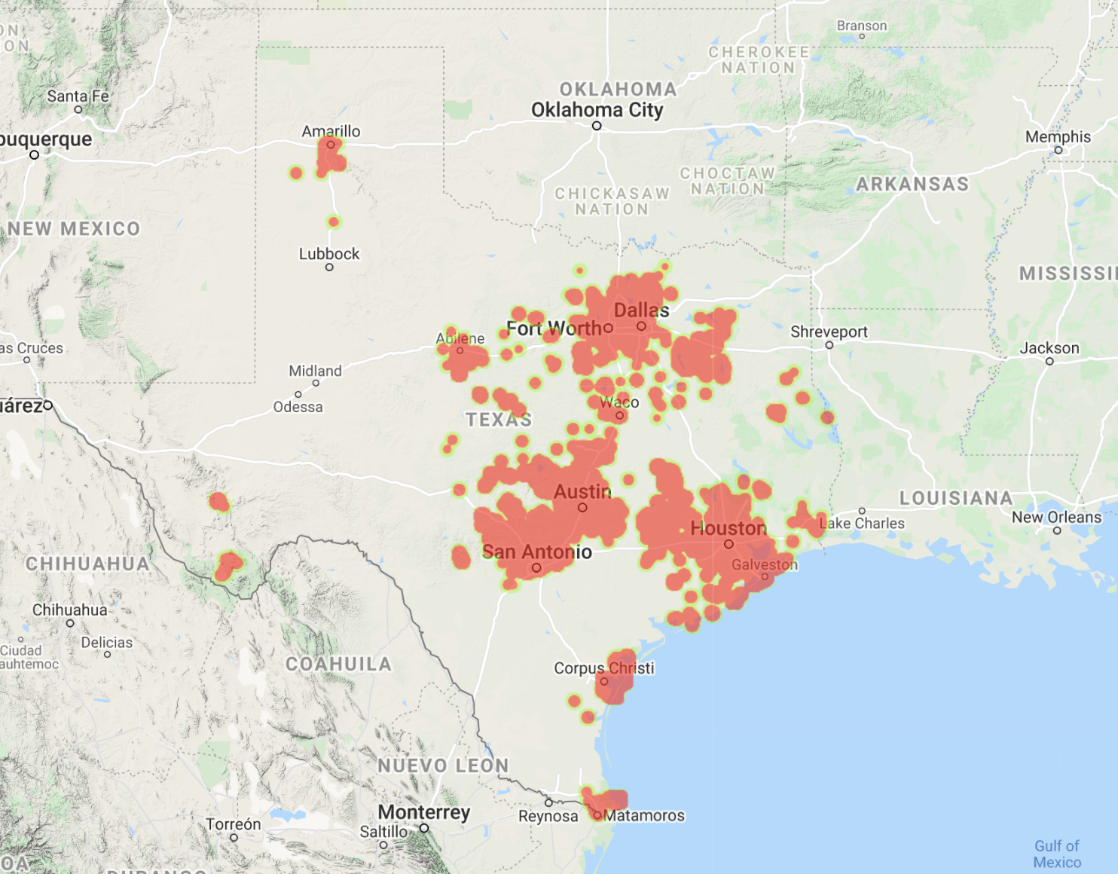
Texas Airbnb Rentals

Slide 8
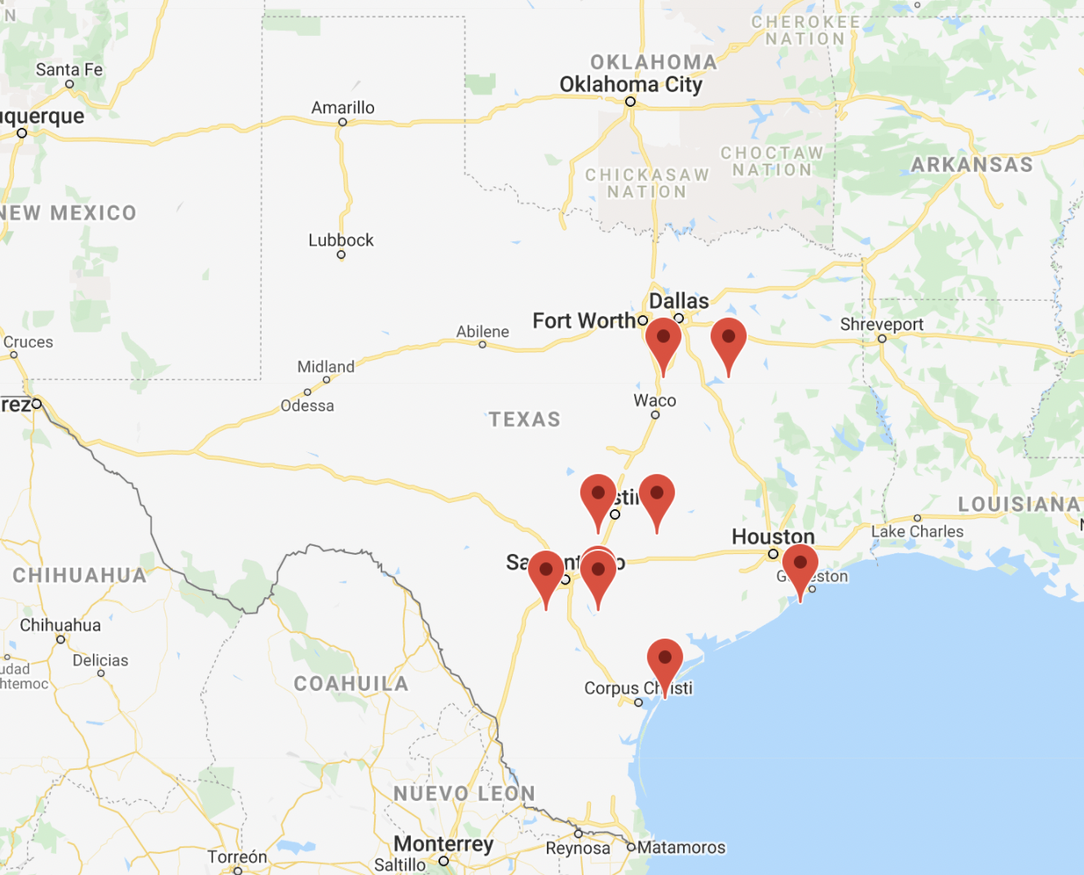
Top 5 Urban & Rural Rentals
Urban Counties
Harris County
Travis County
Tarrant County
Dallas County
Bexar County
Rural Counties
Llano County
Burnet County
Aransas County
Bandera County
Kendall County
Deliverables
Vision
Team
Notes:
Top 5 Urban and Rural Counties makes up 52.5% of the over all data
Top 5 Urban Counties
Harris County - Houston
Travis County - Austin
Tarrant County - Ft. Worth
Dallas County - Dallas
Bexar County - San Antonio
Top 5 Rural Counties
Llano County NW of Austin
Burnet County NW of Austin east of Llano
Aransas County NE of Corpus Christi
Bandera County - NW of San Antonio
Kendall County - NW of San Antonio east of Bandera

Slide 9
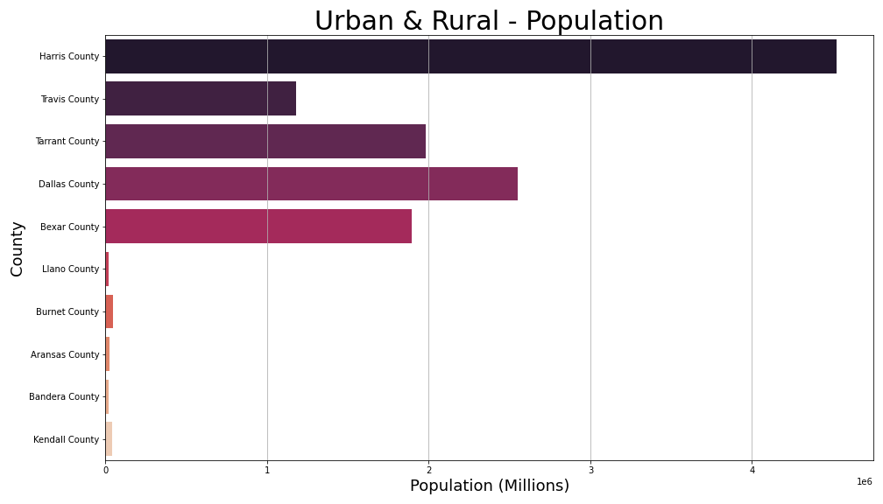
Notes:
Aransas 24832.0
Bandera 21316.0
Bexar 1892004.0
Burnet 45017.0
Dallas 2552213.0
Harris 4525519.0
Kendall 40306.0
Llano 20195.0
Tarrant 1983675.0
Travis 1176584.0

Slide 10
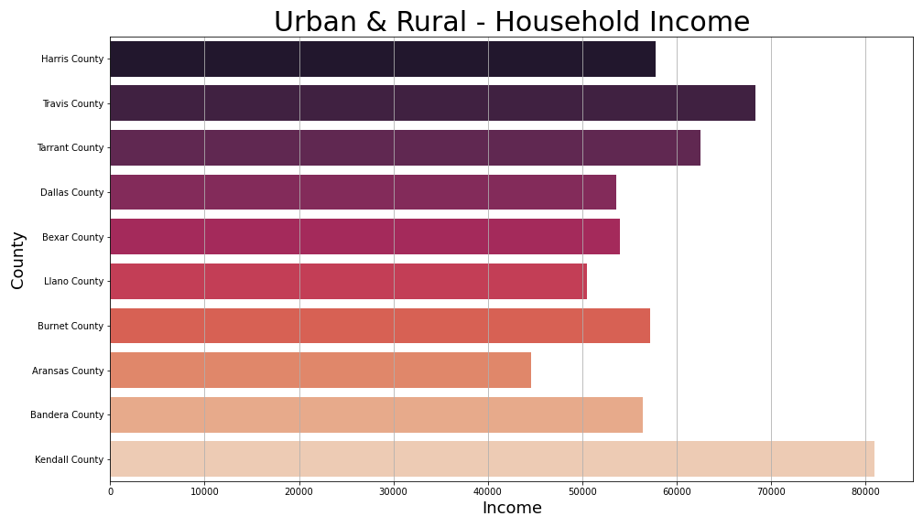
Notes:
Rural counties are fairly close to major urban areas.
We hypothesize residents commute to urban areas.

Slide 11
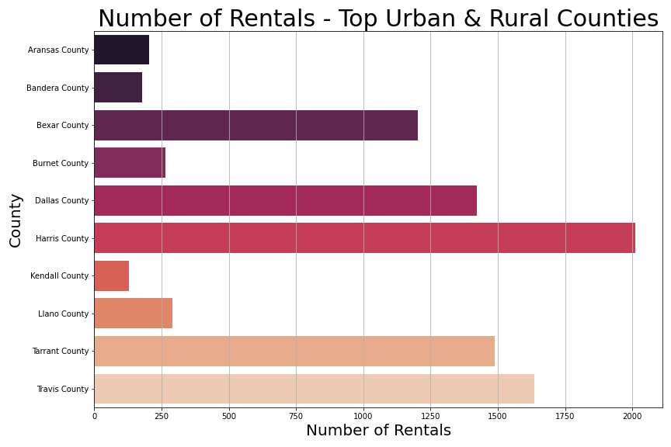
Deliverables
Vision
Team

Slide 12
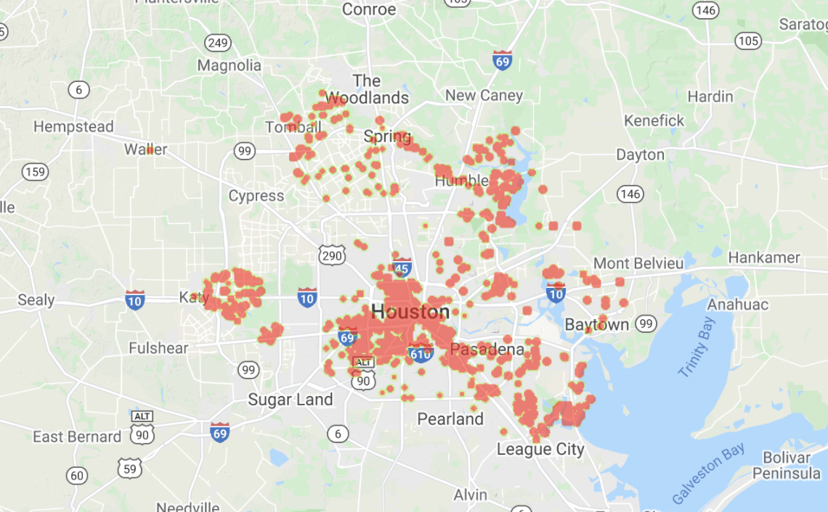
Harris County - Urban
Notes:
This map shows the density of rentals within the county

Slide 13
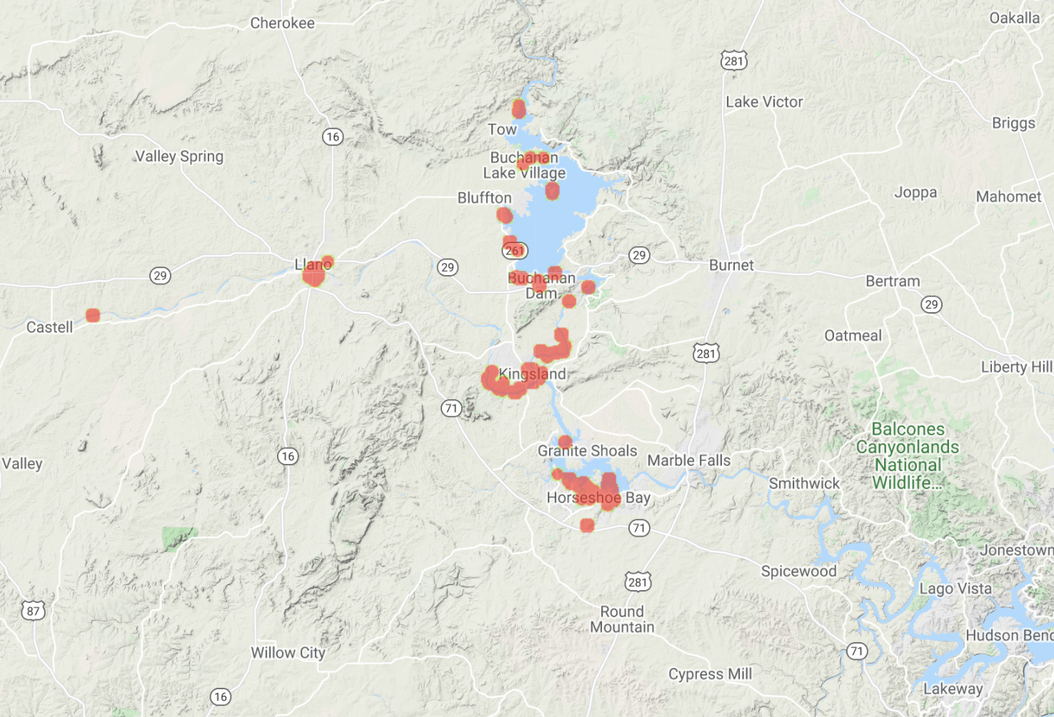
Llano County - Rural

Slide 14
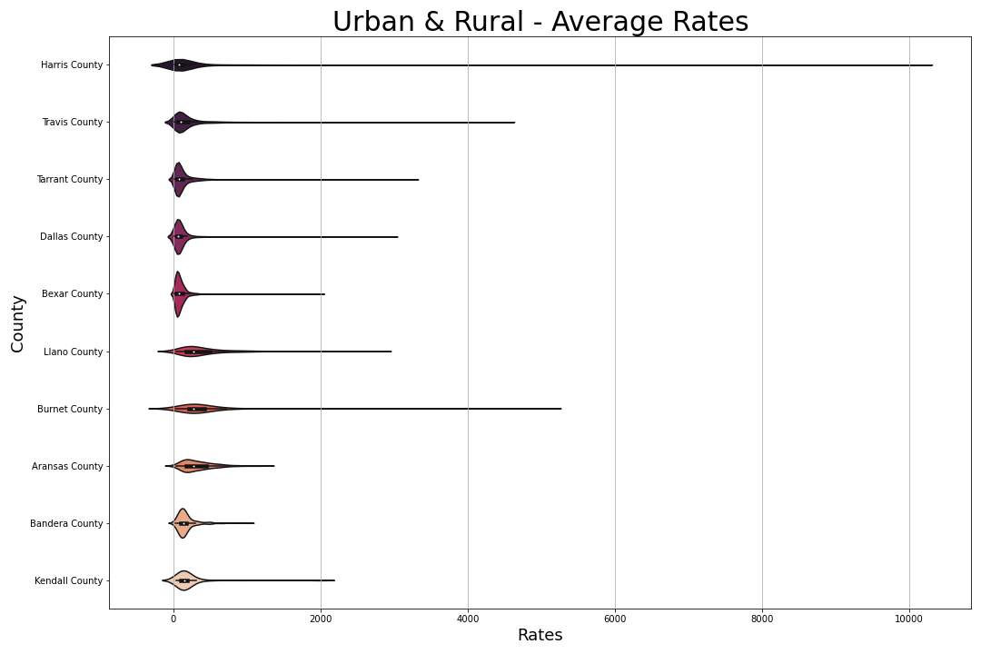

Slide 15
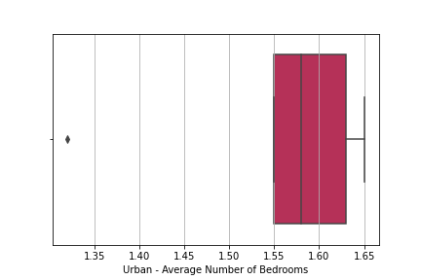
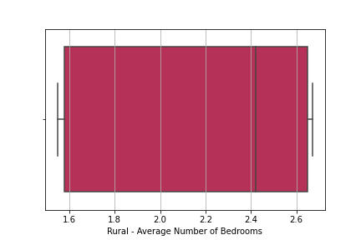
Average Number of Bedrooms

Slide 16
Steven to add Regression Charts

Slide 17


Conclusion
We recommend operating an airbnb rental in a rural area outside a major metropolitan area close to outdoor destinations to maximize profit.
There will be higher rates in rural areas due to less competition.
Rates are slightly higher in rural areas. We also found that the rental size is larger which could contribute to the higher rates.
There are more rentals in areas with tourism attractions.
Population and income affect Airbnb rates.
Need Steven’s Input!
Deliverables
Vision
Team
Notes:
There is less competition in rural areas due to higher rates.
There are more rentals in areas with tourism attractions.
Population and income affect Airbnb rates.
We hypothesize that people want to get out of the city to relax, therefore there will be a higher number of rentals in rural areas.
There is a higher number of business travelers in urban areas, therefore there is a higher need for smaller rentals.

Slide 18
Limitations & Future Work
Data: Not current
Airbnb data is from 2013-2017 (only 6 months of 2017 data available)
Census data is from 2017
Future work:
Look at the effects of rentals during COVID
How long will it take for the market to recover?
Seasonality of Airbnb rentals
Notes:
Seasonality of Airbnb rentals - what time of the year is best to list property?

Slide 19
References
Graphic:
https://hbr.org/2019/04/research-when-airbnb-listings-in-a-city-increase-so-do-rent-prices
Datasets:
https://www.kaggle.com/PromptCloudHQ/airbnb-property-data-from-texas
https://www.kaggle.com/muonneutrino/us-census-demographic-data
Inspiration:
https://www.kdnuggets.com/2017/08/insights-data-mining-airbnb.html
https://public.opendatasoft.com/explore/dataset/air-bnb-listings/map/
Travel:
https://www.traveltexas.com/things-to-do/outdoor-adventure/?gclid=CjwKCAjw0qOIBhBhEiwAyvVcfzmOWPSjpt_oiR-jt5UaiZhYC_qyne15B3Tc1uD5HuzdE6kB0FIRtBoCUPAQAvD_BwE

Slide 20
Q & A Time!

